Slide 1
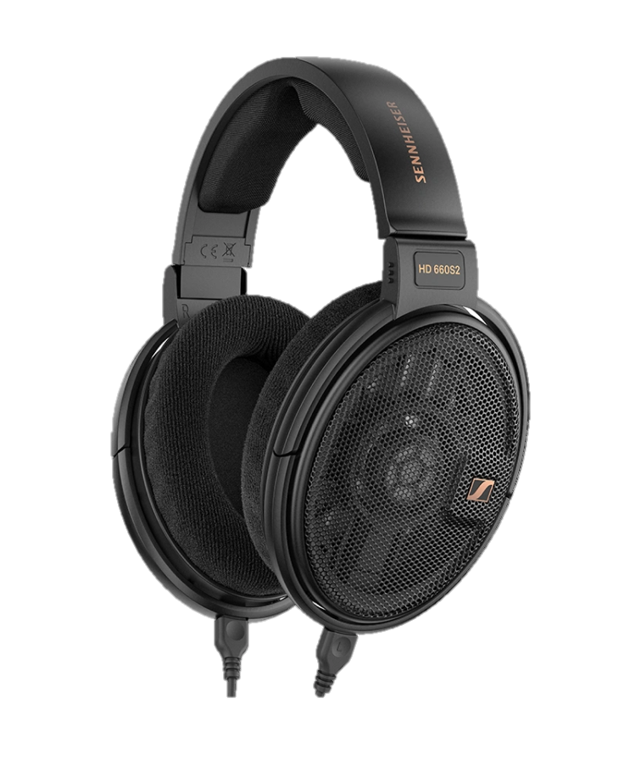
Headphone
Enjoy your music while soaring to a whole new world
Learn more

Slide 2
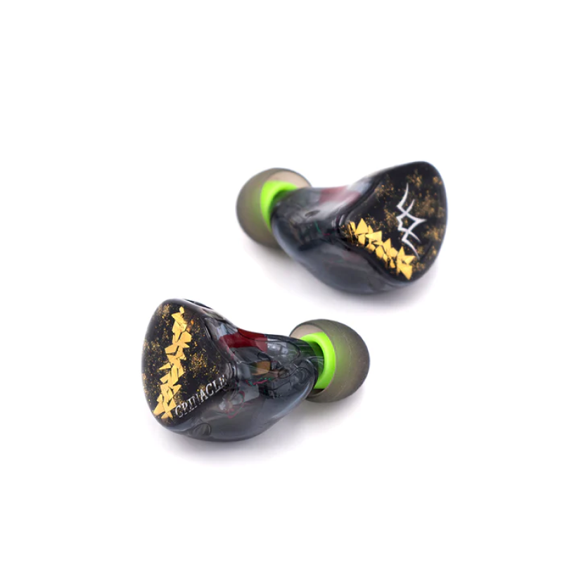
Earphone
Bring your music with you 24/7
Learn more

